Slide 1


MODEL INTERPRETATION USING ELI5, SHAP AND LIME
JAGANNATH BANERJEE

Slide 2
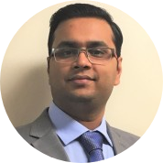
About Me
My Journey
2019 Onwards : Medline Industries
2007 - 2019 : Cognizant US Corp
2007 - 2012 : Cognizant India
Highlights
Built & lead data science teams.
Built Cloud and On-Premise infrastructure for ML Solutions
Implemented Real-time, near real time and batch ML solutions
Worked on Transaction fraud detection system, real time credit line increase, inventory optimization, inventory audit prediction, sentiment reviews and customer feedback analysis
Skillset
ML Engineering & ML Operations
Python – Data Science & ML Packages, Flask, Django
Azure ML Frameworks (Studio, Service, AutoML, Databricks)
Data Scientist | Medline Industries
( Payment Processing & Healthcare )
Get in Touch :
Jagannath.Banerjee@gmail.com
https://www.linkedin.com/in/jagannath-banerjee

Slide 3
AGENDA
Machine Learning - Definition, Infrastructure, Use Case and Advantages - (10 mins)
Model – Insider Look , Reality , Meaning & Importance - (10 mins)
Q & A - (5 mins)
Model Interpretation - (10 mins)
Feature Importance
Eli5
SHAP
LIME
Q & A - (10 mins)

Slide 4



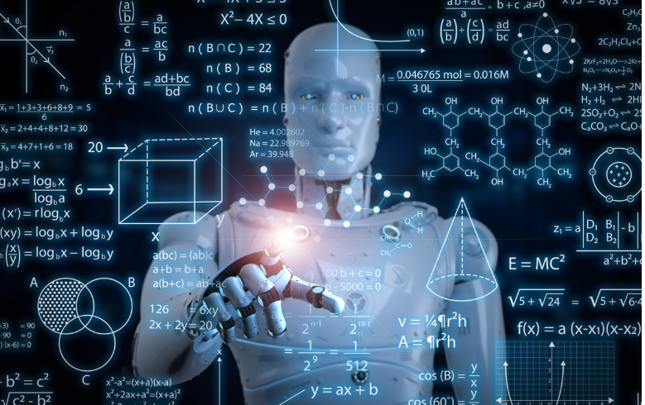
What People Think Machine Learning Is ?
Jagannath Banerjee | https://www.linkedin.com/in/jagannath-banerjee | https://github.com/jbanerje

Slide 5
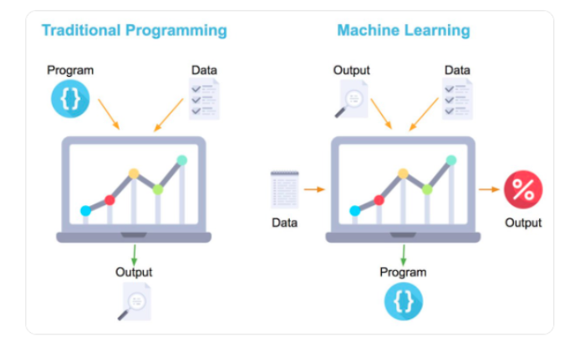
What is Machine Learning ?
Sub-field of artificial intelligence (AI)
Automating simpler human decisions
Identifying patterns in data
Self learns
Model - Mathematical representation of data pattern
Picture Credit : https://towardsdatascience.com/machine-learning-vs-traditional-programming-c066e39b5b17
Jagannath Banerjee | https://www.linkedin.com/in/jagannath-banerjee | https://github.com/jbanerje

Slide 6
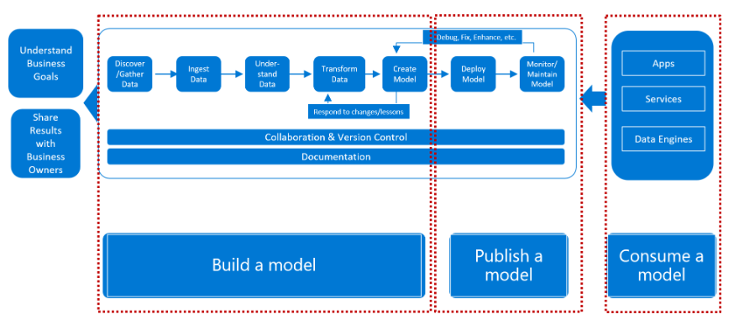
Machine Learning Framework

Slide 7
Flavors of Machine Learning
Regression
Forecast/ Predict profit from Sales
Forecasting stock value
Recommenders
Book & product Recommendation
Movie Recommendation
Classification:
Cat/Dog
Fraud/Not a Fraud
Text Analytics
Financial Trading - Buy, Sell.
Hiring Process
Clustering:
Spam Filtering
Classifying network traffic
Anomaly Detection:
Intrusion Detection
Frauds in claims and payment
Jagannath Banerjee | https://www.linkedin.com/in/jagannath-banerjee | https://github.com/jbanerje

Slide 8
Advantages of Machine Learning
Minimizes mundane human decisions
Frees up bandwidth for creative problem solving
Continuously Improve
Ability to process hundreds of attributes
Works best when programming gets intense with if-else
Jagannath Banerjee | https://www.linkedin.com/in/jagannath-banerjee | https://github.com/jbanerje

Slide 9
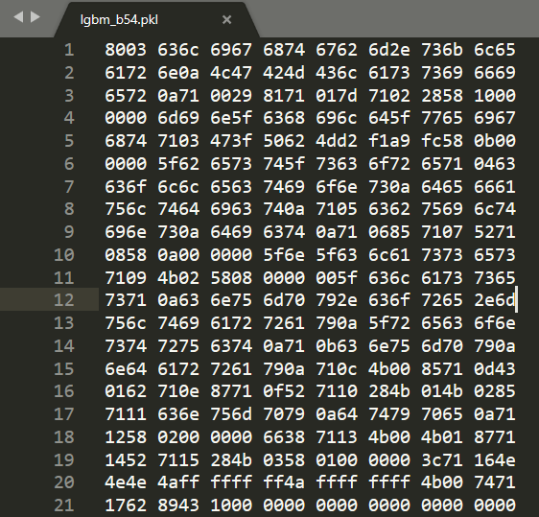

Insider Look into a Model

Slide 10
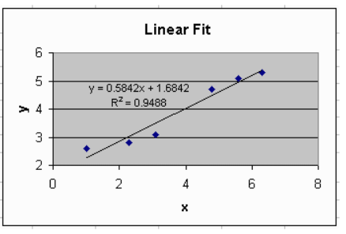
Actual Model
Input(X) | Output(Y)
1 | 2.27
2.2 | 2.97
3 | 3.44
5 | 4.61
5.9 | 5.13
6.2 | 5.31

Slide 11
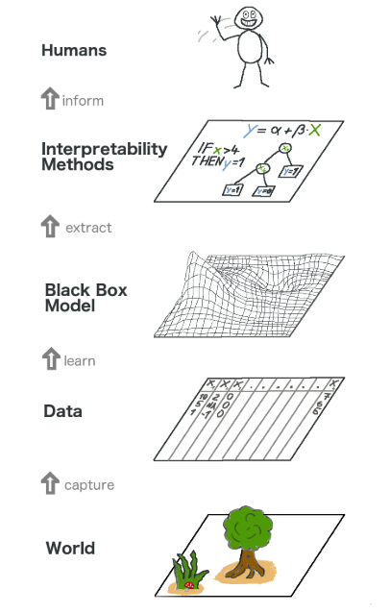
Model Interpretability
Credit : https://christophm.github.io/interpretable-ml-book/agnostic.html

Slide 12




What is meant by Model Interpretability ?
Explain model into human understandable form
Extract useful information
Understand Model behavior
Visualizations

Slide 13
Why Model Interpretability is Important ?
Why model predicted particular output
Build trust factor (fair & un-biased)
Social Acceptance
Whether to deploy a new model
Debug & Audit
When model will fail

Slide 14
Q & A

Slide 15
How to Interpret Machine Learning Model (Model Agnostic Approach)

Slide 16

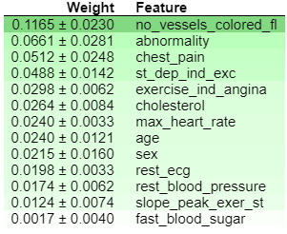
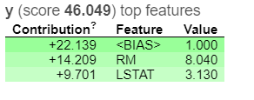
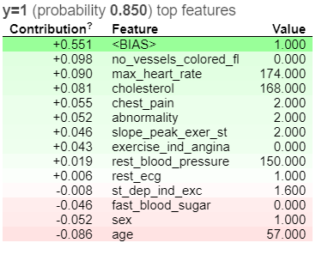
ELI5 - Explain Like I'm 5 !
ELI5 is a Python library which allows to visualize and debug various Machine Learning models using unified API. It has built-in support for several ML frameworks and provides a way to explain black-box models.
Installation:
pip install eli5
conda install -c conda-forge eli5
Regression (Boston Housing)
Classification (Heart Disease)
eli5.show_weights
eli5.show_weights
eli5.show_prediction
eli5.show_prediction

Slide 17
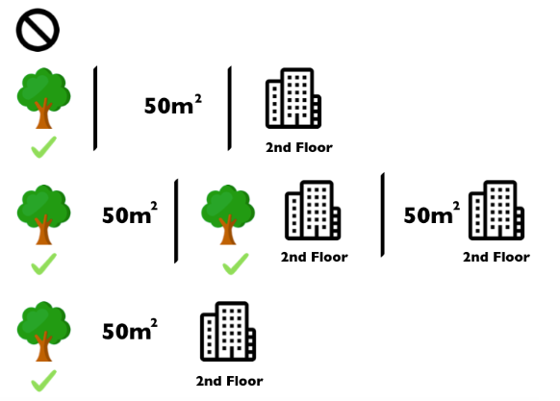
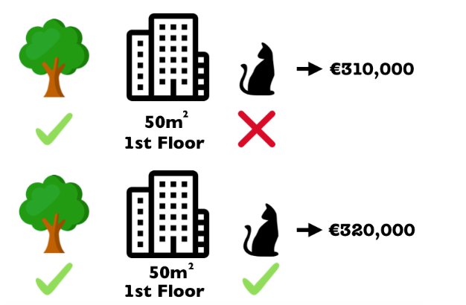
SHAP - SHAPLEY ADDITIVE EXPLANATIONS - 1
Method to explain individual predictions. SHAP is based on the game theoretically optimal Shapley Values.
The Shapley value is the average marginal contribution of a feature value across all possible coalitions
Cat Contribution : 10,000 Pounds
Credit : https://christophm.github.io/interpretable-ml-book/agnostic.html

Slide 18
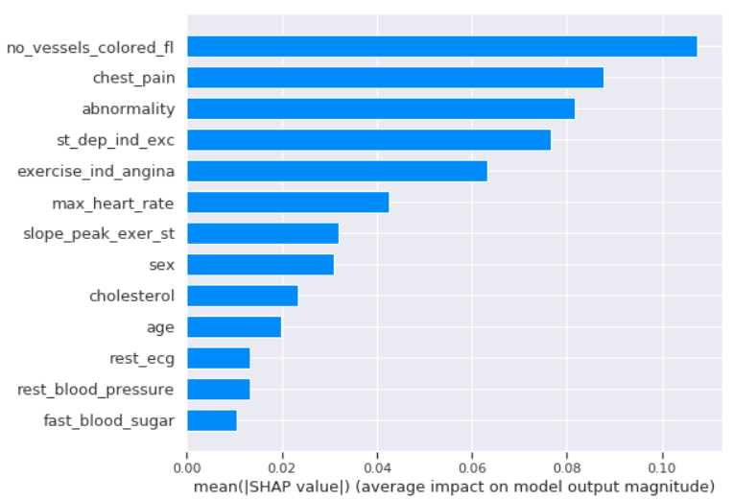
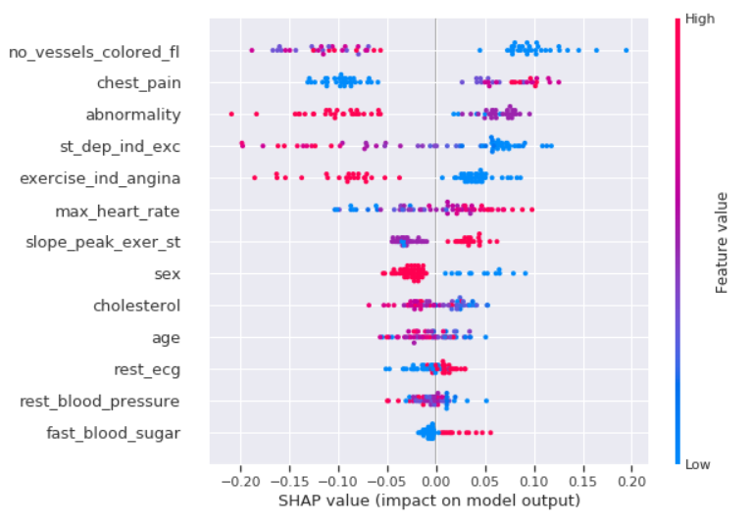
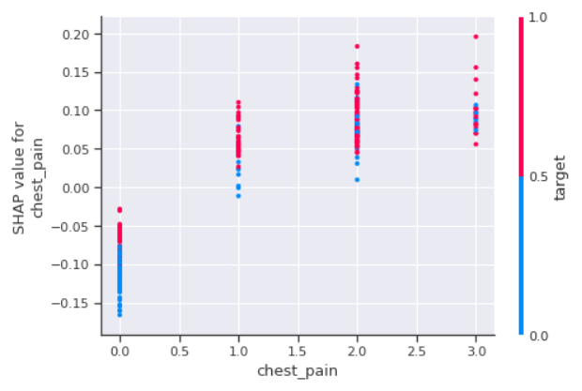
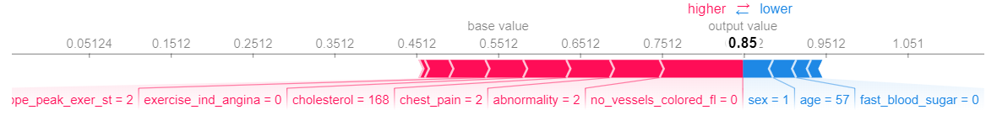
SHAP - SHAPLEY ADDITIVE EXPLANATION - 2
Installation:
pip install shap
conda install -c conda-forge shap
Summary Plot
Dependence Plot
Feature Importance
Force Plot

Slide 19
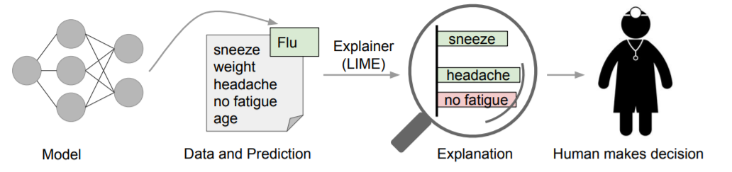
LIME – Local Interpretable Model Agnostic Explanations
Explains the predictions of any classifier or regressor in a faithful way, by approximating it locally with an interpretable model
Installation:
pip install lime
Explanation:
Model predicts that a patient has the flu
LIME highlights the symptoms in the patient’s history that led to the prediction.
Sneeze and headache are portrayed as contributing to the “flu” prediction, “no fatigue” is evidence against it.
doctor can make an informed decision about whether to trust the model’s prediction

Slide 20
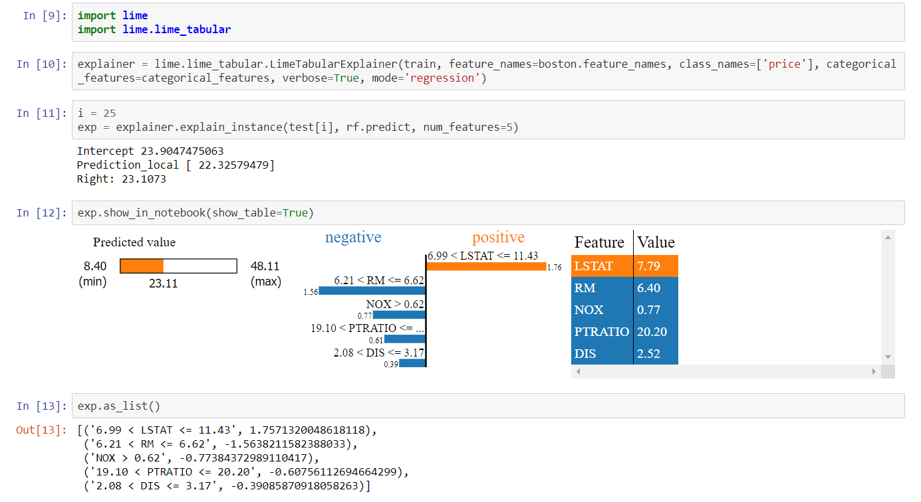
LIME – Local Interpretable Model Agnostic Explanations

Slide 21
Q & A

Slide 22
Appendix

Slide 23
Machine Learning Algorithms
 | Supervised |  | Unsupervised
Algorithms | Regression | Classification | Clustering
Linear Regression | Y
Polynomial Regression | Y
Logistic Regression |  | Y
Support Vector Machines | Y | Y
KNN |  | Y
Naïve Bayes |  | Y
Decision Tree | Y | Y
Random Forest | Y | Y
AdaBoost | Y | Y
CatBoost | Y | Y
XGBoost | Y | Y
LightGradientBoost(LGBM) | Y | Y
K-Mean Clustering |  |  | Y
Hierarchial Clustering |  |  | Y
Jagannath Banerjee | https://www.linkedin.com/in/jagannath-banerjee | https://github.com/jbanerje

Slide 24
Flavors of Machine Learning
Text Analytics:
Financial Trading - Buy, Sell.
Search and selection phases of recruitment.
VOC applications are primarily used by companies to determine what a customer is saying about a product or service
Regression :
Forecast/ Predict profit from Sales
Forecasting stock value based on current value, EPS and other criteria
How much a person is going to live given certain heath conditions
Recommenders:
Amazon - Book & product Recommendation
Netflix - Movie Recommendation
YouTube - Video Recommendation
Classification:
Cat/Dog
Yes/No
Fraud/Not a Fraud
Customer will stay or go
Cancer or not
Anomaly Detection:
IT & DevOps - Intrusion Detection
Bank - Abnormally high transfers, purchases, deposit
Credit Card Fraud
Healthcare - Frauds in claims and payments
Manufacturing - Detect abnormal Machine Behaviors
Clustering:
Spam Filtering
Identifying Fake News
Classifying network traffic
Document Analysis
Jagannath Banerjee | https://www.linkedin.com/in/jagannath-banerjee | https://github.com/jbanerje

